Slide 1
Unit 5 [Users Groups & Permission]
Users
Type UID
Root user 0
System (service) users 1-499
Normal users >=500
#cat /etc/passwd → User’s database file.
Format
username: x : UID : GID : comment : Home Dir : Shell
Note: x → Represents Encrypted password
#cat /etc/shadow → password database file.
Format
useranme: <Encrypted passwords > : <password Aging Policy >

Slide 2
Group
Type UID
Root user’s Group 0
System (service) users Group 1-499
Normal users Group >=500
#cat /etc/group → Group’s database file.
Format
groupname: X : GID : <members_of_group>
Note: X → Represents Encrypted password
Types of Group
i. Primary (Private) Group
ii. Secondary Group

Slide 3
Getting Information About users
$whoami → Displays login name of the current users
$users
$who → Displays information of current logged on users
$w
$groups <username> → Display name of users of which the user is a member
$id <username>
Example
$groups tashi
$cat /etc/group → Information regarding groups with respect to users

Slide 4
Permission
Categories of Users
Owner (u)
Group members (g)
Others (o)
Note : ALL → a
Operators used in changing permission
Operator Meaning
+ To add permission on existing one [Without overwriting existing permission]
= To Absolutely Assign permission [Overwriting existing permission]
__ To remove permission from existing one
Example
case 1 case 2 case 3
Suppose =r_x +w=rwx =w=>_w_ -r=>_ _ x

Slide 5
Types of permission
-------------------------------------------------------------------------------------------------------------
Permission Type Symbolic Representation Numeric Representation
-------------------------------------------------------------------------------------------------------------
Read r 4
Write w 2
Execute x 1
No permission __ 0
Full permission rwx 7
-------------------------------------------------------------------------------------------------------------

Slide 6
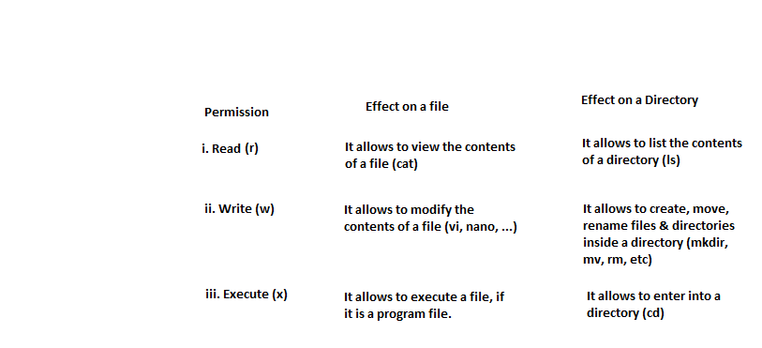
Effects of Permission
Permission Effect on a file Effect on a Directory
-----------------------------------------------------------------------------------------------------

Slide 7
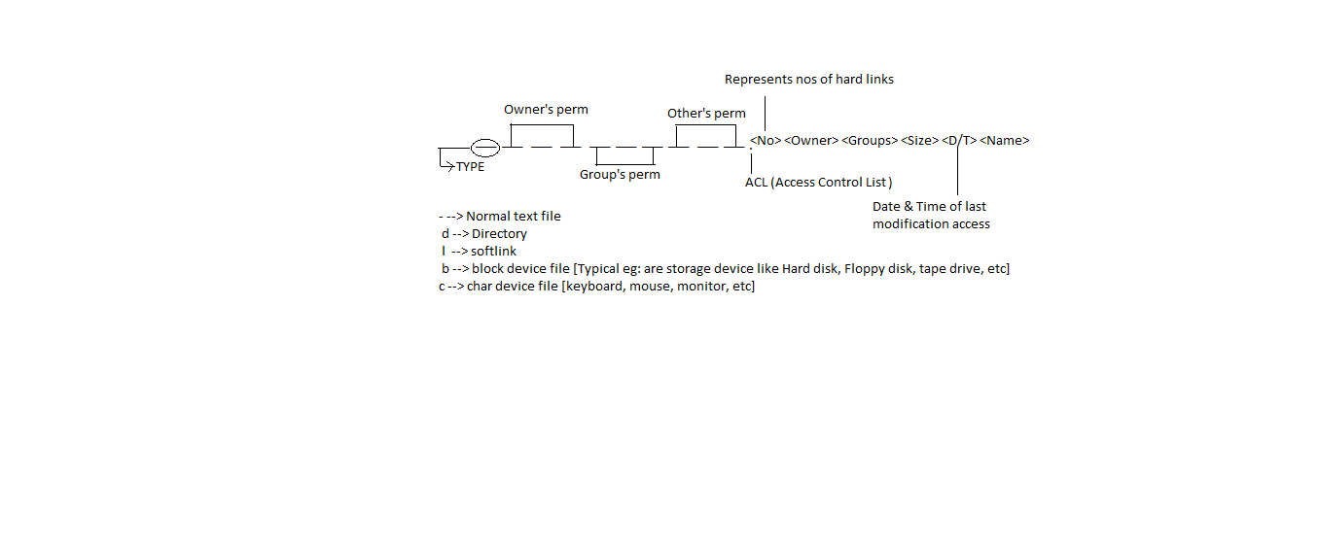
Display Permission on a File/Directory
$ls -l
Notes:
$ls –l /bin
$ls –l /dev
$ls –lh /etc
#du –sh /etc → Displays total disk space occupied by the directory
#df –h → Displays disk allocated & free & used disk space of different partitions

Slide 8
Umask
It is the value that determines default permission on a file or directory at the time of creation.
#umask
0022
#cat > file1
…………
…………
#ls –l file1
_ r w _ r _ _ r _ _
6 4 4
#mkdir dir1
#ls –ld dir1
d r w x r _ x r _ x
7 5 5
$umask
0002
$cat > file2
…………
…………
$ls –l file1
_ r w _ r w _ r _ _
6 6 4
#mkdir dir2
#ls –ld dir1
d r w x r w x r _ x
7 7 5

Slide 9
Renaming & Moving Files
Calculating Default permission
For file
Max. allowed permission at the time of a file creation ( i.e 666)
umask = default permission on a file
Root User Normal User
____ __________
666 666
022 002
----- ------
644 664
Notes:
NOte : Same mv command will do both rename and move file
: If <Destination> is the name of a directory, move operation takes place : If <Destination> is not the name of the direcotory , then rename operation takes place.

Slide 10
ii. For Directory
Max. allowed permission at the time of a directory creation ( i.e 777)
umask = default permission on a directory
Root User Normal User
____ __________
777 777
022 002
----- ------
755 775

Slide 11
$umask → Display current value of umask
$umask <value> → To change the value of umask for the current session only (Temporary)
Q 1. Change the value of umask such that files are created with read and write permission for owner, and no permission for group members and others.
Notes:
1 ans:
666 → default permission for file
600 → permission granted
-----
066 → umask

Slide 12
Setting the value of umask Permanently
Case – I : User specific
$cd
$ls –a
.bashrc → user specific login shell script
$vi .bashrc
Go to bottom
Umask 077
$umask
$exit
Re-login
$umask

Slide 13
Setting the value of umask Permanently
Case – II : System-wide ‘umask’ setting [For All users]
#vi /etc/bashrc →System-wide login shell script
Umask 077 →All Normal users umask
Umask 022 →root’s umask
Note:
Priority goes to user specific even system-wide umask set already
Extra:
#which useradd →Displays absolute path of the command
/user/sbin/useradd
#ls –l /usr/sbin/useradd

Slide 14
Changing Permission of a File
Chmod [option] < File Name >
- R → To set the same permission on a directory & its contents /sub- contents
$ls –l
Q1. Change the permission of a file such that the owner gets full permission, group member gets the read and executes, whereas others gets the execute permission.
Notes:
Q 1 Ans:
rwx r_x _ _ x
7 5 1

Slide 15
Symbolic Method
$chmod u=rwx,g=rx,o=x < File Name>
Eg:
$chmod u=rwx,g=rx,o=x f1
Numeric Method
$chmod 751 f2
Q1. Change the permission of a file such that owner and groups member gets full permission but others get no permission.
Q2. Add execute permission to all categories of users on a file.
Notes:
Q 1 ans:
$chmod u=rwx,g=rwx,o-rwx f3
$chmod 770 f4
Q2 ans:
$chmod ugo+x f5
$chmod a+x f6

Slide 16
THE END

